Slide 1
Classifying NHL Shot Attempts

Slide 2
INtroduction
Problem: What factors most influence whether a shot in an ice hockey game is a success (goal) or failure (no-goal).
What does an NHL season look like? What kind of information could we gather about games or shots?

Slide 3

National Hockey League
31 teams in the league
Each team plays 82 games in a season + post-season playoffs
Over the last 7 seasons teams have averaged between 25 – 40 shots per game but over the same time span only average between 2.5 – 3.1 goals per game

Slide 4
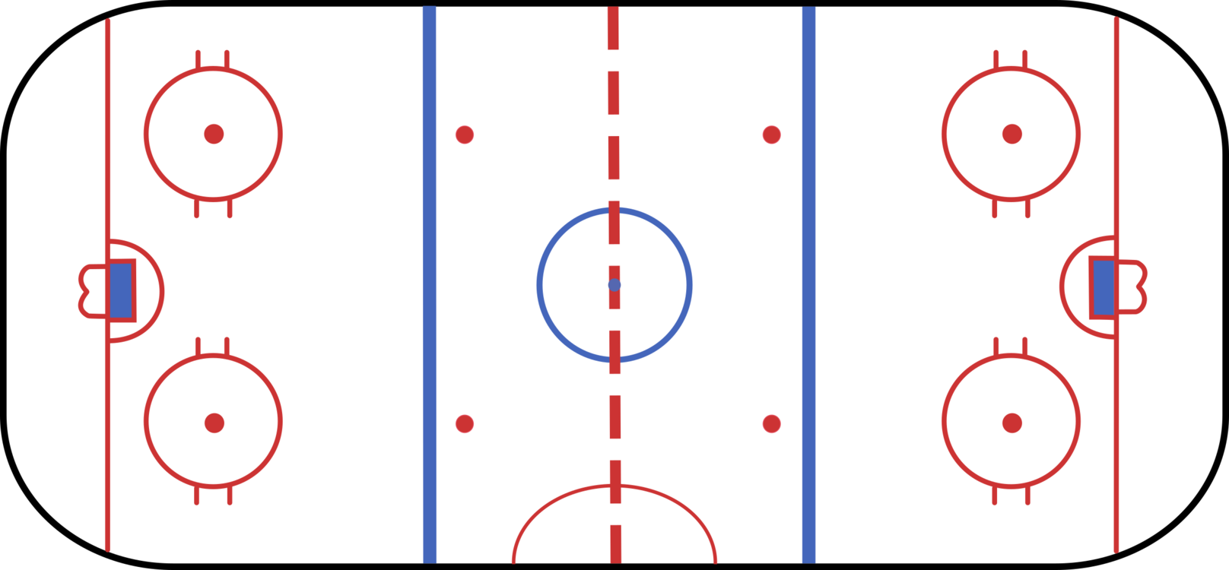
A look into the game
2
4
Zones
Faceoff Circles
Crease
Behind Goal
Blue Line
5
3

Slide 5
Relating to the Data
Dataset used in this analysis consists of 660,000+ shots with ~60,000 of them resulting in goals
Shot types: Backhand, Deflection, Slap Shot, Snap Shot, Tip-In, Wrap-Around, Wrist Shot
Additional possible features: Shot coordinates (X,Y), rink side, players, teams, period type (regular / overtime), time remaining
Need to choose features and use the result of our shot (goal: 1, no goal:0 ) as the target

Slide 6
Where do the shots occur?
2
4
Zones: Slap Shot, Wrist Shot
Faceoff Circles: Wrist Shot
Crease : Backhands, Deflections, Wrist
Behind Goal : Wrap Around
Blue Line: Slap Shot
5
3

Slide 7
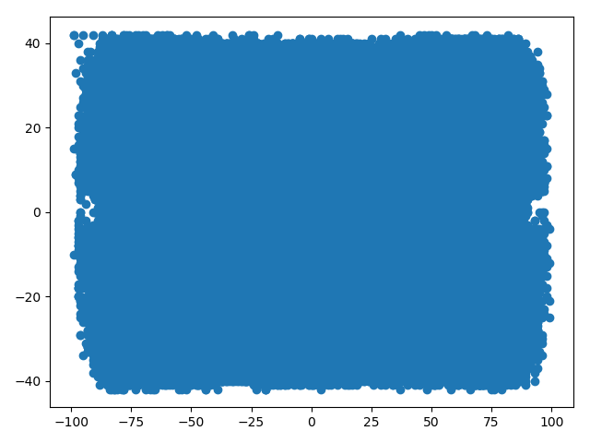
A look at the shots

Slide 8
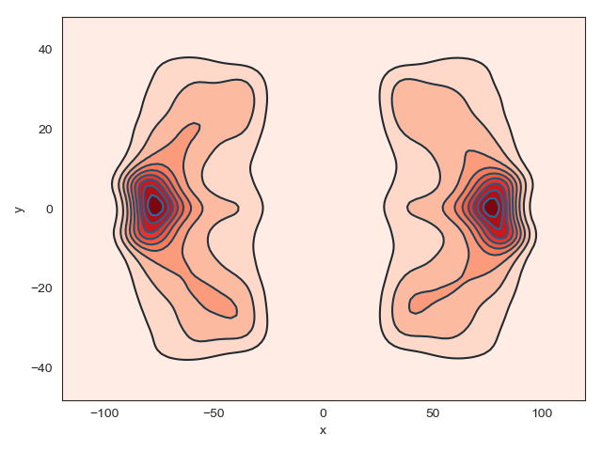
A look at the shots

Slide 9
Feature Selection
Just from visualizing the shots locations it’s apparent that the coordinates are probably of interest to the analysis
Perfomed Principal Component Analysis (PCA) to reduce the dimension selection based on variance or magnitude of their coefficient
The 4 features chosen to focus on were X-Y Coordinates, Shot Type, and TeamFor_ID based on the results of PCA

Slide 10
Algorithm Chosen
Just from visualizing the shots locations it’s apparent that the coordinates are probably of interest to the analysis
Perfomed Principal Component Analysis (PCA) to reduce the dimension selection based on explained variance
The 4 features chosen to focus on were X-Y Coordinates, Shot Type, and TeamFor_ID based on the results of PCA
Decision Tree Classifier was chosen based on number of features for a first attempt

Slide 11
First Attempt
On the first attempt of classifying whether a shot is a goal or no-goal based on the features selected
Tried using a decision tree classifer from sklearn with no parameters tweaked and there was a result of 0.84 accuracy.
Not terrible, but could be better

Slide 12
Second Attempt
On the second attempt at classifying whether or not a shot was a goal, the decision tree split qualifier was set to consider information gain as a factor for decision making.
The result here pushed the classifying accuracy up to 91%

Slide 13
Results
The validation of these results was not as conclusive as I would have liked them to be
A confusion matrix showed overfitting on true negatives and struggled to correctly classify true positives
Too similar results for features we have and not enough data for “x factors” i.e shots can go in or not go in from pretty much every location on the ice, goalie, etc….
Limiting shots to 1 side of the ice had no effect
Even though shot location had a high magnitude coefficient as compared to others
True | 0 | 178577 | 3016
Label | 1 | 17814 | 132
 |  | 0 | 1
 |  | Predicted | Label

Slide 14
Summary
While location may be a strong feature to classify whether or not a shot is successful, it alone is not enough to train an algorithm
Would have much more thoroughly investigated during preprocessing if possible

Slide 15
How Would I continue this Research
Combine results with another method of classification for better resulsts
Normalize the shot data more throroughly
Go further in-depth analyzing shot selection for specific players/teams
Try to find goalie stop data for specific shot id’s (couldn’t find 1:1)

